Slide 1
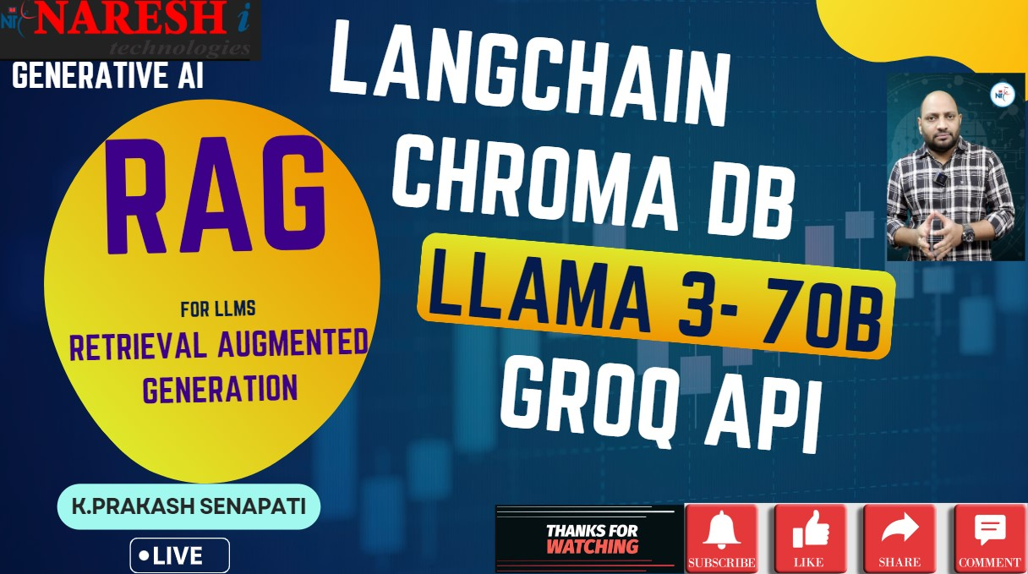

Slide 2

WORKSHOP ON RAG (RETRIEVAL AUGUMENTED GENERATION
MY INTRODUCTION
TRADITIONAL LLM MODEL VS RAG BASED MODEL?
WHAT IS RAG ?
WHAT KIND OF PROBLEMS RAG USED FOR ?
RAG ARCHITECTURE
SIMPLE MODEL RAG vs MULTIMODEL RAG
RAG PRACTICLE
NEW BATCH DETAIL INFORMATION
PREVIOUS CLASS RECORDINGS
Q & A

Slide 3
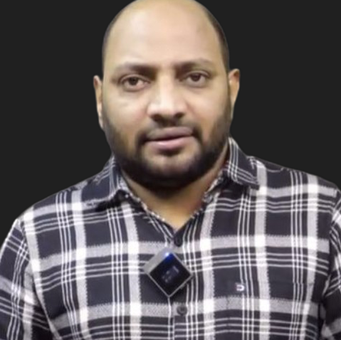
MY INTRODUCTION
LEAD DATASCIENTIST @ NARESH IT → K. PRAKASH SENAPATI
INDUSTRY EXPERIENCE → 17+YRS
WORK EXPERIENCE→ KROGER IT | GENPACT | VALUELABS | MPHASIS | ITFAS | KIABI | A3MAX |
TEACHING EXPERIENCE → SYNERGISTIC SOFTWARE SOLUTIONS | IIIT-BANGALORE UPGRADE |
GREAT LEARNING | CORPORATE TRAINER | NARESH IT
PERMANENET WORKING CLIENT → EUROPEAN BASED CLIENT
TRAINING MODE→ OFFLINE & ONLINE
OFFLINE LOCATION→ AMEERPET, HYDERBAD
OFFLINE LAB → PHYSICAL LAB & ONLINE LEARNER → VIRTUAL LAB
DURATION→ 5-6 MONTHS & TIME →8:30AM
CLASS DAY→ MON - FRI || 2nd & 4th WEEK– SATURDAY
MICROSOFT CERTIFIED DATASCIENTIST
GOOGLE CERTIFIED GENERATIVE AI ENGIEER
LINKEDIN →https://www.linkedin.com/in/kodi-prakash-senapati-a95a60182/

Slide 4
WHAT IS RAG ?
Each step can be broken down to:
Retrieval - Seeking relevant information from a source given a query. For example, getting relevant passages of Wikipedia text from a database given a question.
Augmented - Using the relevant retrieved information to modify an input to a generative model (e.g. an LLM).
Generation - Generating an output given an input. For example, in the case of an LLM, generating a passage of text given an input prompt.

Slide 5
TRADIONAL LLM MODELS
QUERY
USER
LLM
RESPONSE
RAG BASED SYSTEM
DATA STORE IN VECTOR DATABASE
QUERY
USER
RETRIEVAR
QUERY
TEXT
GENERATE RESPONSE
LLM

Slide 6
WHAT KIND OF PROBLEMS CAN RAG USED FOR?
RAG can help anywhere there is a specific set of information that an LLM may not have in its training data (e.g. anything not publicly accessible on the internet).
Customer support Q&A chat - By treating your existing customer support documentation as a resource, when a customer asks a question, you could have a system retrieve relevant documentation snippets and then have an LLM craft those snippets into an answer. Think of this as a "chatbot for your documentation
Email chain analysis - Let's say you're an insurance company with long threads of emails between customers and insurance agents. Instead of searching through each individual email, you could retrieve relevant passages and have an LLM create strucutred outputs of insurance claims.
Company internal documentation chat - If you've worked at a large company, you know how hard it can be to get an answer sometimes. Why not let a RAG system index your company information and have an LLM answer questions you may have? The benefit of RAG is that you will have references to resources to learn more if the LLM answer doesn't suffice.
Textbook Q&A - Let's say you're studying for your exams and constantly flicking through a large textbook looking for answers to your questions. RAG can help provide answers as well as references to learn more.
All of these have the common theme of retrieving relevant resources and then presenting them in an understandable way using an LLM.

Slide 7
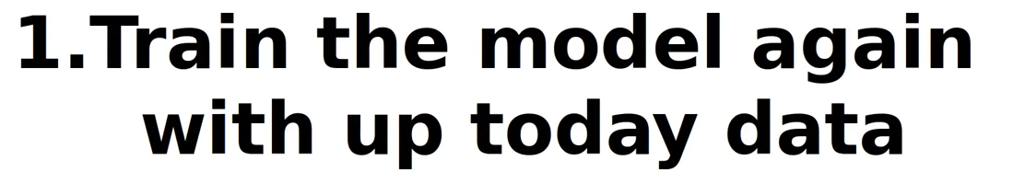
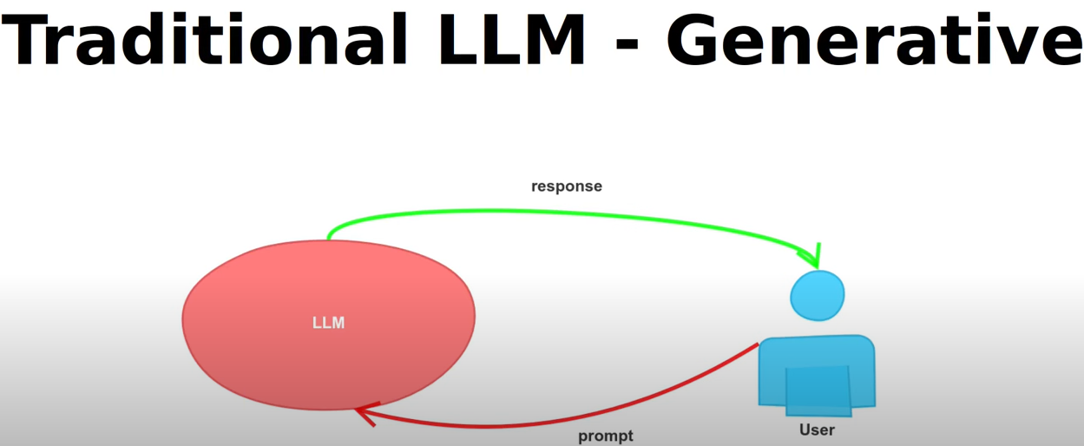
LLM Models are ->
GPT
GEMINI
LLAMA3
- Some times these LLM model not update on time.
- To train the model it takes lot of time & more expenses

Slide 8
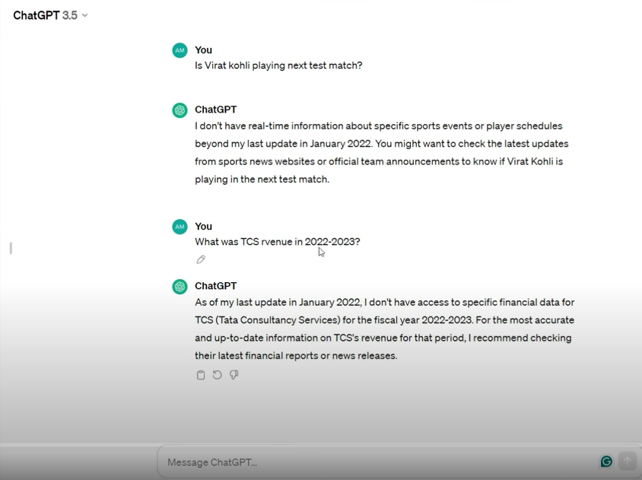
1st problem →
LLM models are not up to date
Revenue is not confidential . In google all news are available.
Why we are search in llm models the reason being we are looking for specific information & update information.
That is where rag comes into the picture

Slide 9
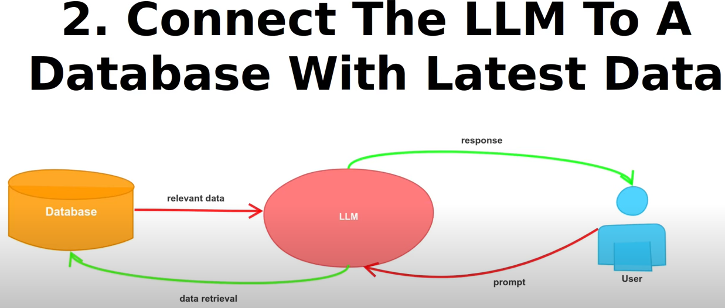

Slide 10
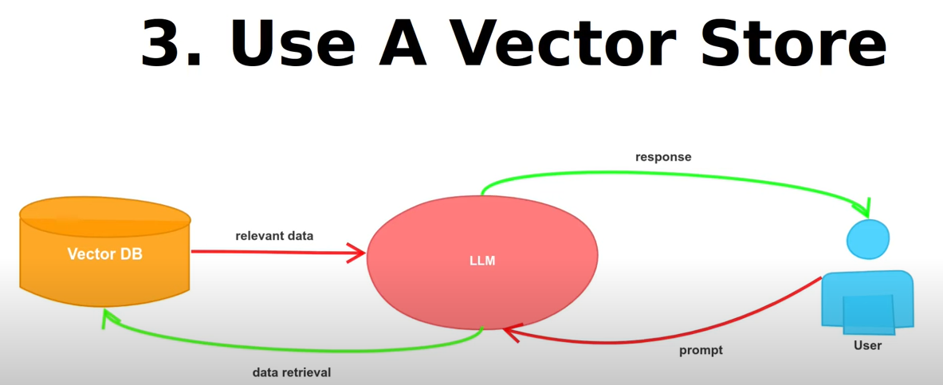
- vector store is bunch of collision vector embeeding into different information.
- Basically instead of showing words and store in vector form.
- These database are called as vector database.

Slide 11
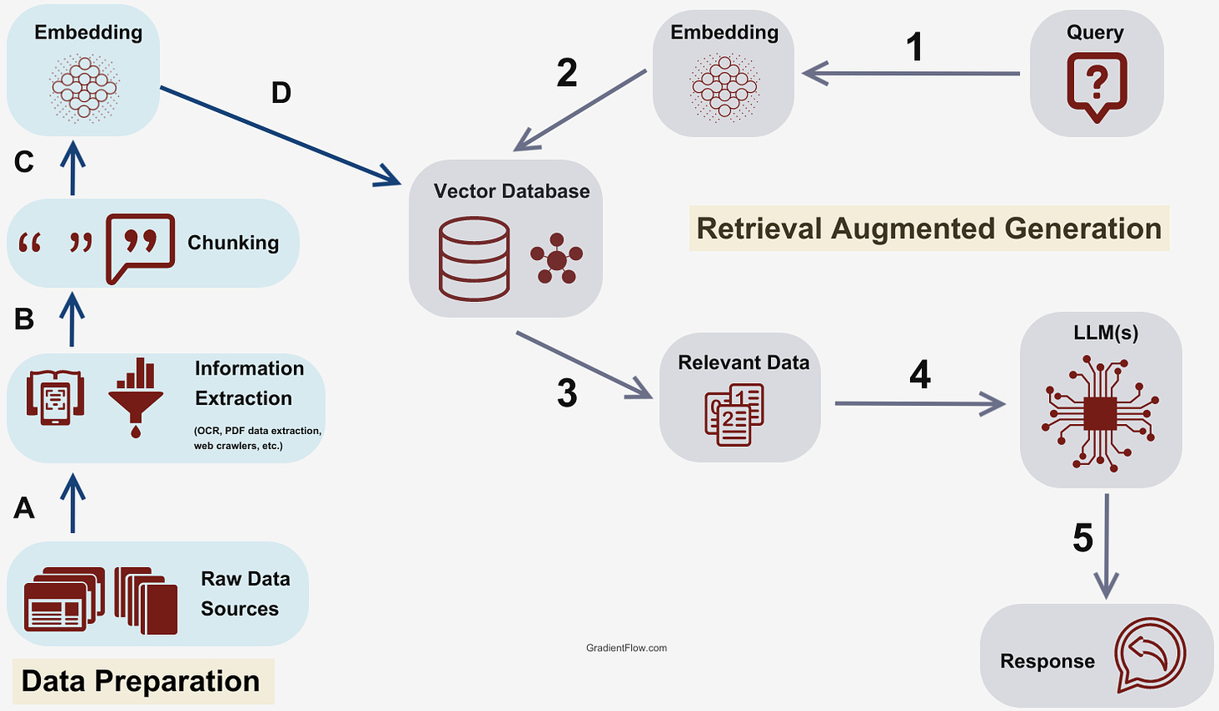
RAG ARCHITECTURE

Slide 12
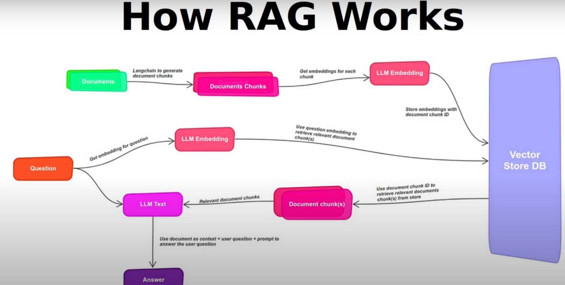

Slide 13
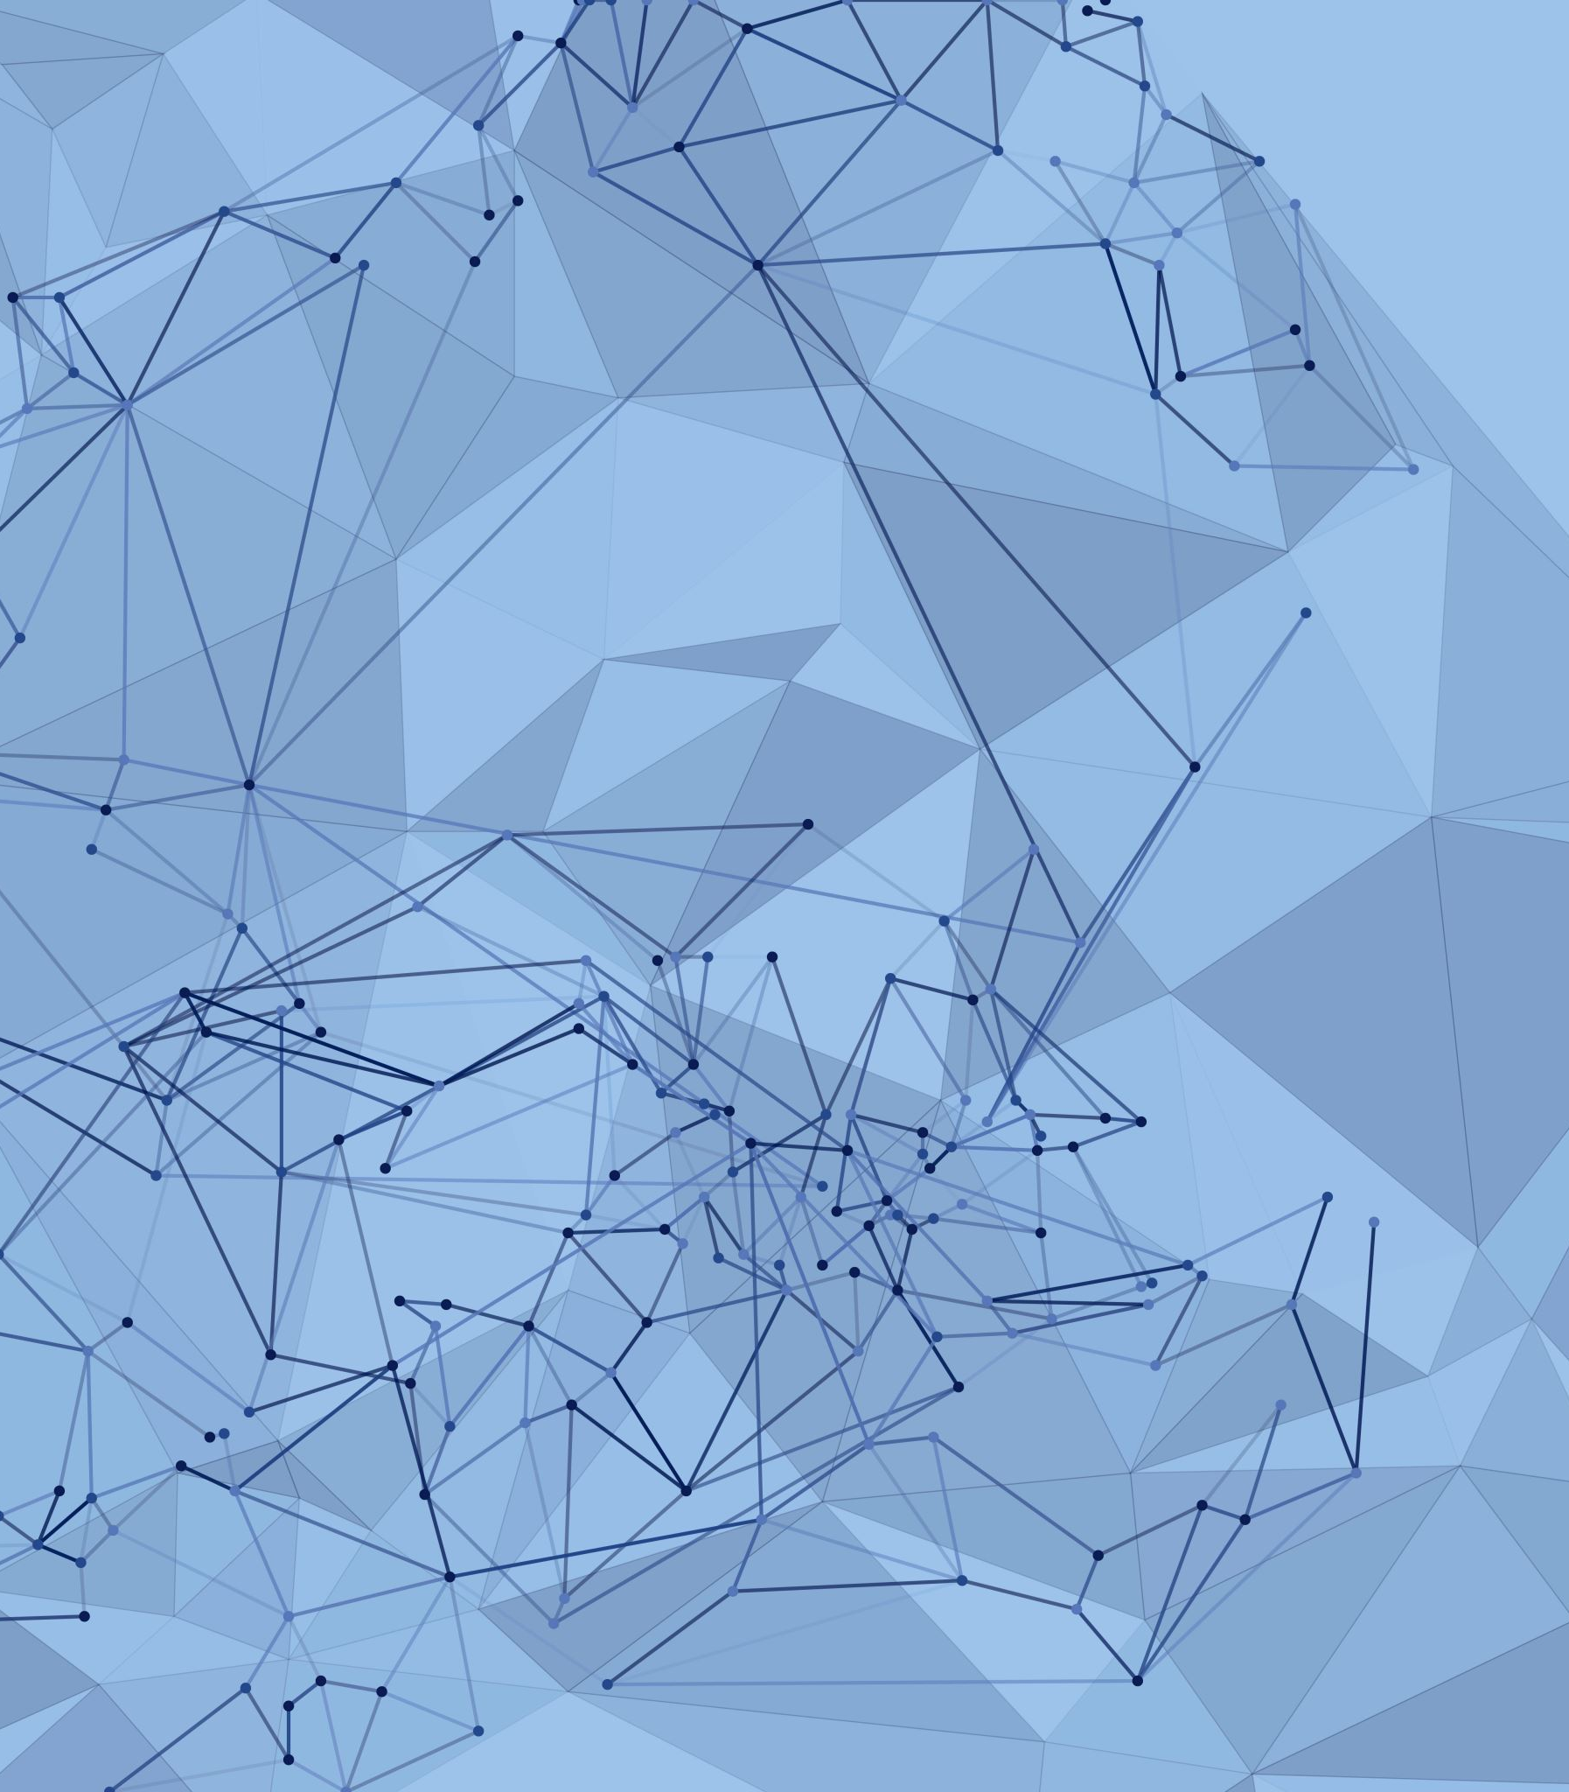
RAG PRACTICLE
SOFTWARE APPLICATION – GOOGLE COLAB
FRAMEWORK – LANGCHAIN
LLM MODEL – LLAMA3 70B Parameter
LPU = GROQ API
HUGGING FACE

Slide 14
SIMPLE MODEL RAG vs MULTIMODEL RAG
Simple Model RAG:
Retrieval Process: This version of RAG involves retrieving relevant text or data from a database or document based on a query.
Generation Process: After retrieval, the generative model processes the retrieved data to produce the final output, typically in text form.
Multimodal RAG:
Retrieval Process: In this version, retrieval extends beyond text and may include multiple data types (modalities) such as images, videos, or audio files. The system retrieves relevant information from various sources, not just text databases.
Generation Process: The generative model then processes this multimodal data to produce a comprehensive output that could involve text, images, or other forms of media.
Key Differences:
Data Sources: Simple Model RAG focuses on text-based retrieval, while Multimodal RAG integrates data from multiple formats (e.g., text, images, etc.).
Applications: Simple Model RAG is suited for tasks like text generation or question answering, whereas Multimodal RAG can be used for more complex tasks involving different types of data, such as generating captions for images or creating multimedia content.
These two approaches highlight the flexibility of RAG in handling different types of data, depending on the specific application requirements.

Slide 15

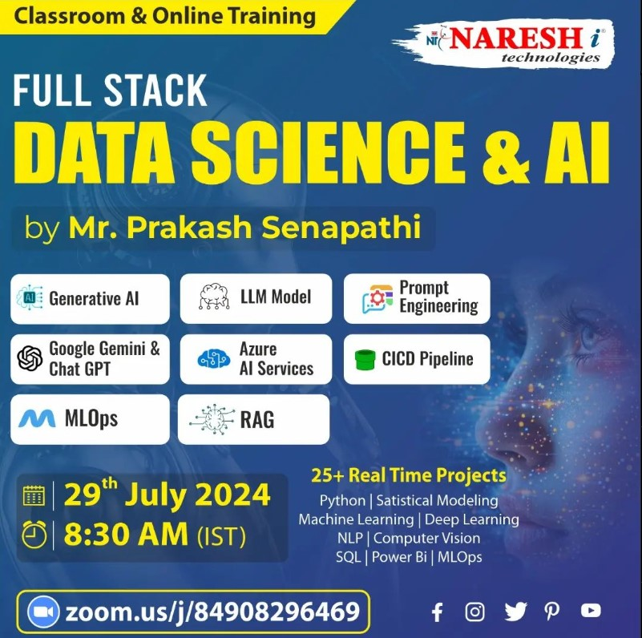
New Training Batch offline & online
Full Stack DATA SCIENCE, AI, Generative AI
Mr. Prakash Senapati | Dt: 29th July
Time: 8:30AM (IST)

Slide 16
GENERATIVE AI SESSION
1- ChatGPT Tutorial for Developers | Introduction to ChatGPT : youtube.com/watch?v=SDStCnlITT8
2- Generative AI Workshop : youtube.com/watch?v=Xp1MnygECUs
3- LARGE LANGUAGE MODEL : youtube.com/watch?v=v0w9LXXrsys
4- COMPLETE DATA SCIENCE LIBRARY: youtube.com/watch?v=MsFhUjFL4vE&t=209s
5- Know About Data Science & Generative AI: youtube.com/watch?v=TR_OCx5z-m8
6- Generative AI with Langchain, Langsmith, OpenAI & LLMops
youtube.com/watch?v=MAkXifYHnuw&t=1320s
7- Google Generative AI | Gemini AI: youtube.com/watch?v=BDrXdvNh19Q&t=5684s
8- Generative AI for Build LLM Model Using Lama 3,Hugging Face & Ollama
youtube.com/watch?v=eDN6fAWLNNE&t=5425s
9- GEMMA-9B Integration with GROQ, HUGGINGFACE & LANGCHAIN
youtube.com/watch?v=Bp1XyvMvedg&t=7086s
10- NLP: youtube.com/watch?v=s-xhKH-e8ig&t=5844s

Slide 17
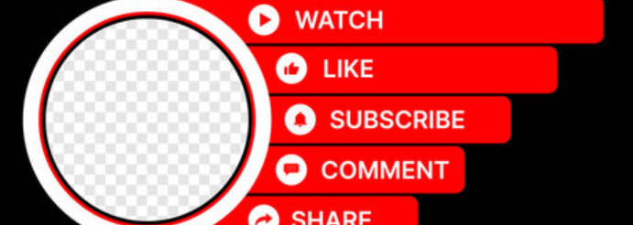
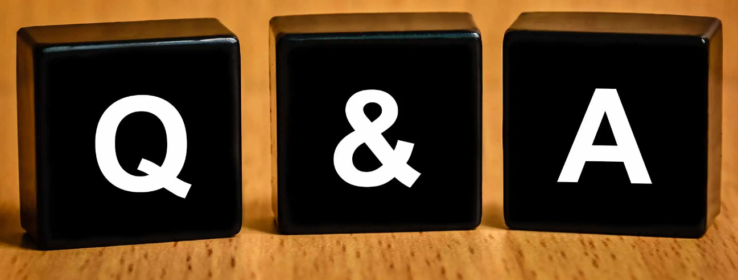
https://drive.google.com/drive/u/0/folders/1sHsaHEf4-e8VwFI2GLu8pWDZIlzhZB_4

